Slide 1

Introducing Classes and Class Diagrams

Slide 2
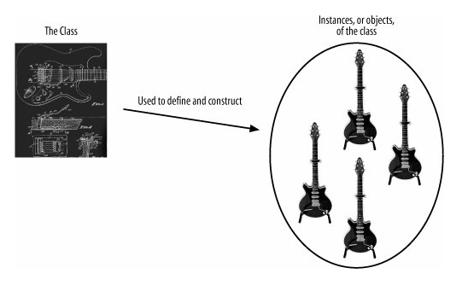
A Class
A class is a type of something. You can think of a class as being the blueprint out of which objects can be constructed

Slide 3
The Information Kept by a Class
a class's description will include two pieces of information:
The state information (Attributes) that objects of the class will contain
The behavior (Operations) that they will support
Attributes and operations are the mainstays of a class's description

Slide 4
Abstraction
Discarding irrelevant details within a given context is called abstraction.
This means that only those attributes are added to a class that really matter. Extra information that is not going to be used by the model of the entire system is discarded
A model, by definition, is an abstraction of the system that it represents. The actual system is the real thing; the model contains only enough information to be an accurate representation of the actual system.

Slide 5
Encapsulation
Encapsulation of operations and attributes within an object is probably the single most powerful and useful part of the object-oriented approach to system design.
Encapsulation enables a class to hide the inner details of how it works from the outside world.
With Encapsulation, a class can change the way it works internally and as long as those internals are not visible to the rest of the system, those changes will have no effect on how the class is interacted with.

Slide 6
Getting Started with Classes
A class in UML is drawn as a rectangle split into up to three sections.
The top section contains the name of the class,
the middle section contains the attributes or information that the class contains, and …
the final section contains the operations that represent the behavior that the class exhibits.
The attributes and operations sections are optional. If they are not shown, it does not necessarily imply that they are empty

Slide 7
Four Ways for Representing a Class
ClassName
ClassName
ClassName
ClassName
Attribute
Attribute
Attribute
Attribute
Operation
Operation
Operation
Operation

Slide 8
Visibility
You can control access to attributes, operations, and even entire classes to effectively enforce encapsulation by applying visibility characteristics
There are four different types of visibility that can be applied to the elements of a UML model
Public
Protected
Package
Private

Slide 9
Public Visibility
Public visibility is specified using the plus (+) symbol before the associated attribute or operation. Declare an attribute or operation public if you want it to be accessible directly by any other class.

Slide 10
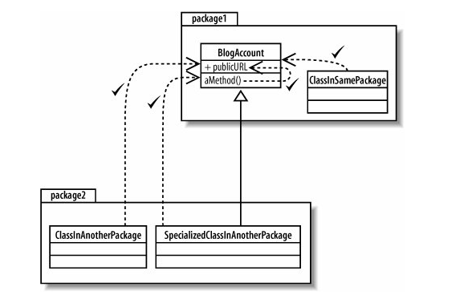
Example
Using public visibility, any class within the model can access the publicURL attribute

Slide 11
Public Interface
The collection of attributes and operations that are declared public on a class create that class's public interface. (avoid unnecessary sets and gets)
The public interface of a class consists of the attributes and operations that can be accessed and used by other classes.
It is important that the public interface to your classes changes as little as possible to prevent unnecessary changes wherever your class is used.

Slide 12
Protected Visibility
Protected attributes and operations are specified using the hash (#) symbol.
They are more visible to the rest of your system than private attributes and operations, but are less visible than public.
Declared protected elements on classes can be accessed by methods that are part of your class and also by methods that are declared on any class that inherits from your class.

Slide 13
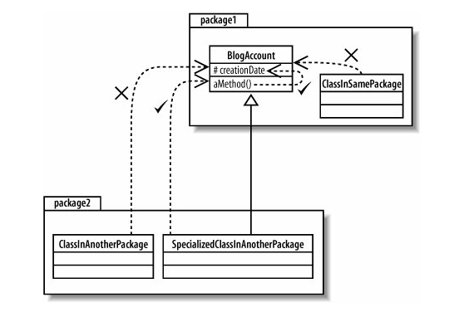
Example

Slide 14
Package Visibility
Package visibility, specified with a tilde (~), when applied to attributes and operations, sits in between protected and private.
Packages are the key factor in determining which classes can see an attribute or operation that is declared with package visibility.
Classes outside the package cannot access these attributes or operations even if it's an inheriting class.

Slide 15
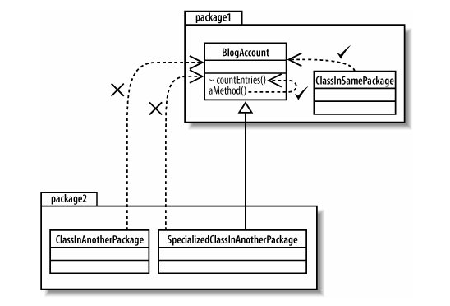
Example

Slide 16
Private Visibility
Private visibility is the most tightly constrained type of visibility classification, and it is shown by adding a minus (-) symbol before the attribute or operation.
Only the class that contains the private element can see or work with the data stored in a private attribute or make a call to a private operation.
In well-designed OO systems, attributes are usually private or protected, but very rarely public.

Slide 17
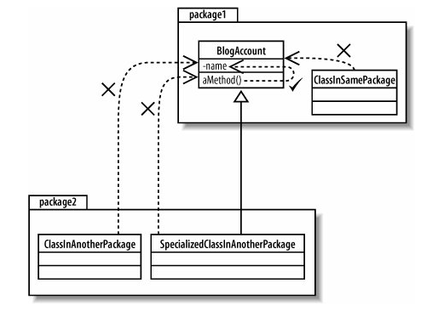
Example

Slide 18
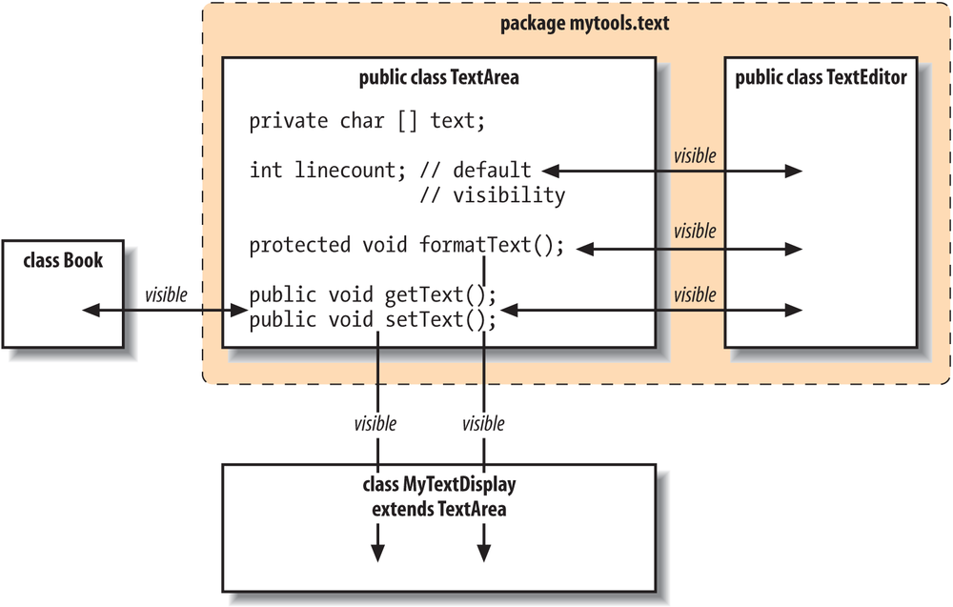
Reference: https://www.oreilly.com/library/view/learning-java-4th/9781449372477/ch06s04.html

Slide 19
Visibility
Modifier | Visibility outside the class
private | None
No modifier (default) | Classes in the package
protected | Classes in package and subclasses inside or outside the package
public | All classes

Slide 20
Class State: Attributes
A class's attributes are the pieces of information that represent the state of an object.
These attributes can be represented on a class diagram either by placing them inside their section of the class box known as inline attributes or by association with another class

Slide 21
Attribute Name & Type
An attribute's name can be any set of characters, but no two attributes in the same class can have the same name.
The type of attribute can vary depending on how the class will be implemented in your system but it is usually either a class, such as String, or a primitive type, such as an int in Java.
When naming attributes, it's worth trying to come up with a name that describes the information that the attribute represents.

Slide 22
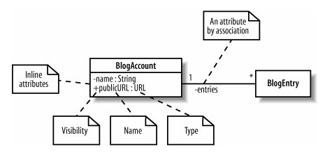
Example

Slide 23
When defined in Java …
public class BlogAccount
{
  // The two inline attributes
  private String name;
  public URL publicURL;
  // The single attribute by association, given the name 'entries'
  private BlogEntries[] entries;
  // ...
}

Slide 24

Multiplicity
Multiplicity allows you to specify that an attribute actually represents a collection of objects, and it can be applied to both inline and attributes by association.

Slide 25
The trackbacks, comments, and authors attributes all represent collections of objects.
The * at the end of the trackbacks and comments attributes specifies that they could contain any number of objects of the Trackback and Comment class, respectively.
The authors attribute is a little more constrained since it specifies that it contains between one and five authors.

Slide 26
The entries attribute that is introduced using an association between the BlogAccount class and the BlogEntry class has two multiplicity properties specified at either end of the association.
A * at the BlogEntry class end of the association indicates that any number of BlogEntry objects will be stored in the entries attribute within the BlogAccount class.
The 1 specified at the other end of the association indicates that each BlogEntry object in the entries attribute is associated with one and only one BlogAccount object.

Slide 27
The unique property dictates that no two Trackback objects within the array should be the same.
The ordered property is used in this case to indicate that each of the Comment objects is stored in a set order, most likely in order of addition to the BlogEntry.

Slide 28
Class Behavior: Operations
The collection of all the operations that a class contains should totally encompass all of the behavior that the class contains, including all the work that maintains the class's attributes and possibly some additional behavior that is closely associated with the class.
Operations in UML are specified on a class diagram with a signature that is at minimum made up of a visibility property, a name, a pair of parentheses in which any parameters that are needed for the operation to do its job can be supplied, and a return type.

Slide 29
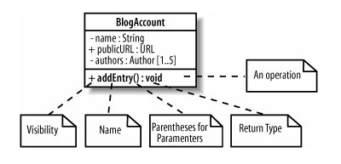
Example

Slide 30
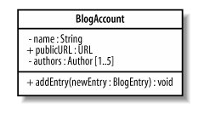
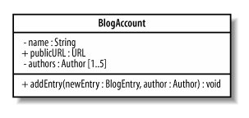
Parameters
Parameters are used to specify the information provided to an operation to allow it to complete its job. For example, the addEntry(..) operation needs to be supplied with the BlogEntry that is to be added to the account.

Slide 31
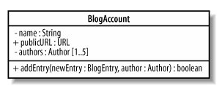
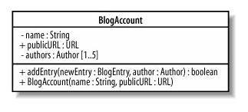
Return Type
A return type is specified after a colon at the end of an operation's signature and specifies the type of object that will be returned by the operation
A constructor creates and returns a new instance of the class that it is specified in, therefore, it does not need to explicitly declare any return type

Slide 32
Static Parts
In UML, operations, attributes, and even classes themselves can be declared static.
Sometimes you want all of the objects in a particular class to share the same copy of an attribute or operation. This is where static attributes and operations become useful.
An attribute or operation is made static in UML by underlining it.

Slide 33
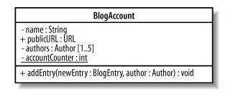
Example

Slide 34
Automobile
- name : String
- model : int
- horsePower : int
passengers : int
milage : int
#resetMilage():void
+ getName(): String
+ getModel(): int
+ getHorsePower(): int
+ getPassengers(): int
Car
Truck
- racing: Boolean
1
*
+ unload(): Car
+ load(car : Car)
- cars{ordered}
+ isRacing(): Boolean

